Slide 1
Project „ACH“ (Applied Crypto Hardening)
www.bettercrypto.org

Slide 2

Motivation
(Aaron)

Slide 3
Don‘t give them anything for free
It‘s your home, you fight

Slide 4
TL;DR - Quickinfos
Website: www.bettercrypto.org
Git repo: https://git.bettercrypto.org
Mailing list: http://lists.cert.at/cgi-bin/mailman/listinfo/ach

Slide 5
Who?
Wolfgang Breyha (uni VIE), David Durvaux (CERT.be), Tobias Dussa (KIT-CERT), L. Aaron Kaplan (CERT.at), Christian Mock (coretec), Daniel Kovacic (A-Trust), Manuel Koschuch (FH Campus Wien), Adi Kriegisch (VRVis), Ramin Sabet (A-Trust), Aaron Zauner (azet.org), Pepi Zawodsky (maclemon.at),
New contributors: IAIK, A-Sit
Aaron

Slide 6
Idea
Do at least something against the Cryptocalypse
Check SSL, SSH, PGP crypto Settings in the most common services and certificates:
Apache, Nginx, lighthttp
IMAP/POP servers (dovecot, cyrus, ...)
openssl.conf
Etc.
Create easy, copy & paste-able settings which are „OK“ (as far as we know) for sysadmins.
Keep it short. There are many good recommendations out there written by cryptographers for cryptographers
Many eyes must check this!

Slide 7
Contents so far
Disclaimer
Methods
Elliptic Curve Cryptography
Keylengths
Random Number Generators
Cipher suites – general overview & how to choose one
Recommendations on practical settings
Tools
Links
Aaron
Notes:
Green == main chapter

Slide 8
Methods
How we develop this whitepaper
Public review
We need your review!
Aaron

Slide 9
General remarks on crypto

Slide 10
Some thoughts on ECC
Currently this is under heavy debate
Trust the Math
“Nothing Up My Sleeve Numbers”
eg. NIST P-256 (http://safecurves.cr.yp.to/rigid.html)
Coefficients generated by hashing the unexplained seed c49d3608 86e70493 6a6678e1 139d26b7 819f7e90.
Might have to change settings tomorrow
Most Applications only work with NIST-Curves
Ramin, Daniel

Slide 11
Keylengths
http://www.keylength.com/
Recommended Keylengths, Hashing algorithms, etc.
Currently:
RSA: >= 3248 bits (Ecrypt II)
ECC: >= 256
SHA 2+ (SHA 256,…)
AES 128 is good enough
Ramin, Daniel

Slide 12
AES 128? Isn‘t that enough?
“On the choice between AES256 and AES128: I would never consider using AES256, just like I don’t wear a helmet when I sit inside my car. It’s too much bother for the epsilon improvement in security.”
— Vincent Rijmen in a personal mail exchange Dec 2013
Some theoretical attacks on AES-256

Slide 13
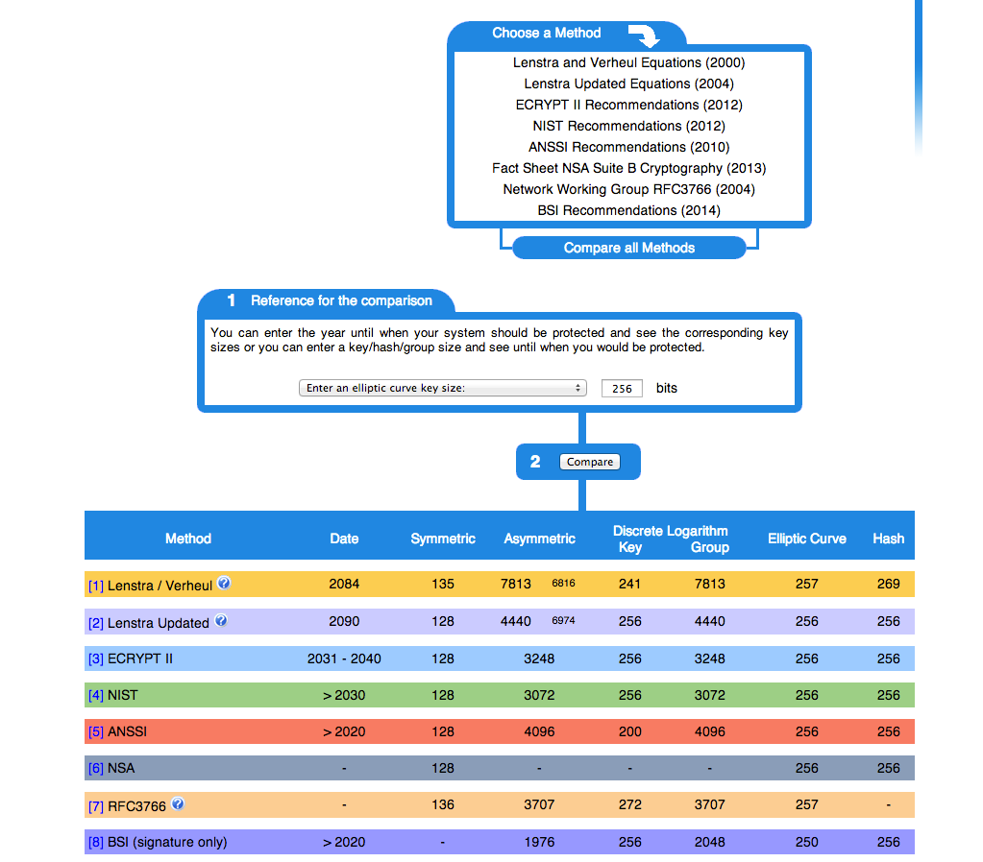

Slide 14
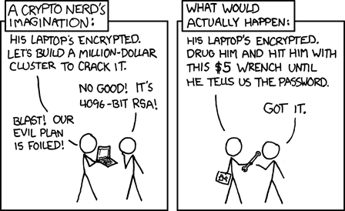
Forward Secrecy-Motivation:
Three letter agency (TLA) stores all ssl traffic
Someday TLA gains access to ssl-private key (Brute Force, Physical Force)
TLA can decrypt all stored traffic
Ramin, Daniel

Slide 15
Perfect Forward Secrecy
DHE: Diffie Hellman Ephemeral
Ephemeral: new key for each execution of a key exchange process
SSL private-Key only for authentication
Alternative new ssl private key every x days months
Pro:
Highest Security against future attacks
Contra:
Elliptic Curve
Processing costs

Slide 16
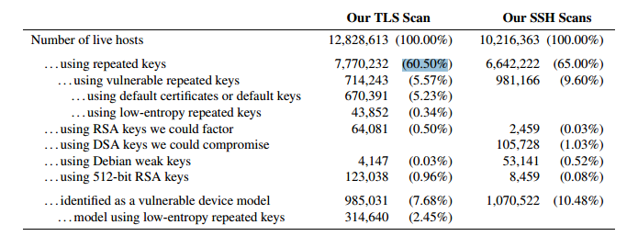
RNGs
RNGs are important.
Nadia Heninger et al / Lenstra et al
Entropy after startup: embedded devices

Slide 17
RNGs
Weak RNG
Dual EC_DRBG is weak (slow, used in RSA-toolkit)
Intel RNG ? Recommendation: add System-Entropy (Network). Entropy only goes up.
Tools (eg. HaveGE http://dl.acm.org/citation.cfm?id=945516)
RTFM
when is the router key generated
Default Keys ?
Re-generate keys from time to time

Slide 18
Attacks
Ramin, Daniel

Slide 19
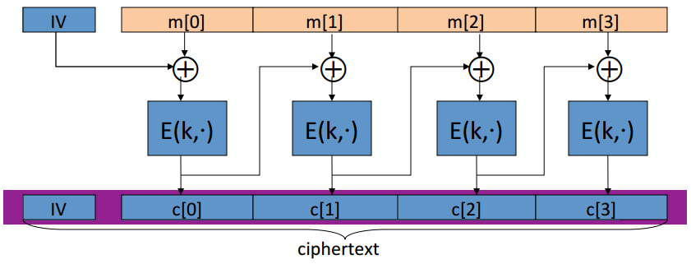
Attacks - BEAST
Browser Exploit Against SSL/TLS (BEAST) attack
Predict IV of CBC
Subsequent packet use IV that is the last cyphertext block of the previous packet
Chosen Plaintext Attack (eg. Cookie-name)
Ramin, Daniel

Slide 20

Attacks - CRIME
Compression Ratio Info-leak Made Easy (CRIME) attack
Sidechannel attack
Information based on compressed size of http requests
MITM, Bruteforce: Client Javascript to Browse to …
Compressed size smaller when secretcookie correct.

Slide 21
Cipher suites

Slide 22
Some general thoughts on settings
General
Disable SSL 2.0 (weak algorithms)
Disable SSL 3.0 (BEAST vs IE/XP)
Enable TLS 1.0 or better
Disable TLS-Compression (SSL-CRIME Attack)
Implement HSTS (HTTP Strict Transport Security)
Variant A: fewer supported clients
Variant B: more clients, weaker settings

Slide 23
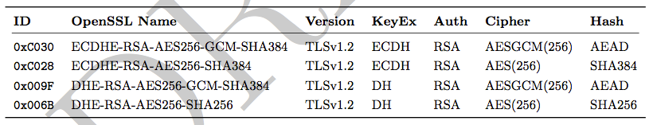
Variant A
’EECDH+aRSA+AES256:EDH+aRSA+AES256:!SSLv3’
Compatibility:
Only clients which support TLS1.2 are covered by these cipher suites (Chrome 30, Win 7 and Win 8.1, Opera 17, OpenSSL ≥ 1.0.1e, Safari 6 / iOS 6.0.1, Safari 7 / OS X 10.9)

Slide 24
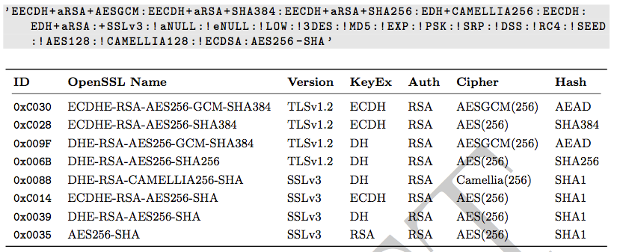
Variant B
weaker ciphers, many clients

Slide 25
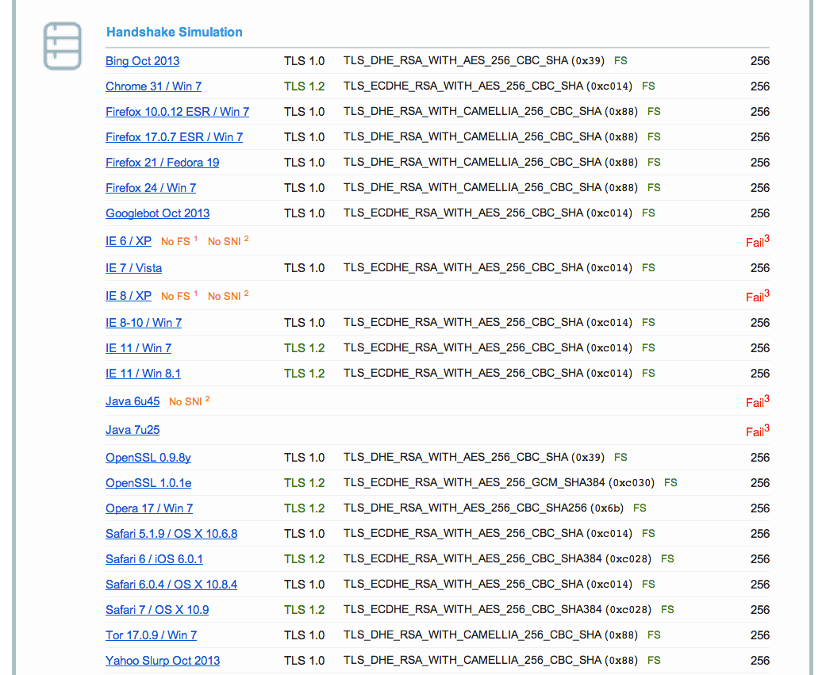
Variant B: Compatibility
End-of-life

Slide 26
Choosing your own cipher string (1)
Rolling your own cipher suite string involves a trade-off between:
Compatibility (server <-> client), vs.
Known weak ciphers/hashes/MACs
The choice ECC or not, vs.
Support by different ssl libs (gnutls, openssl,...) vs.
Different versions of ssl libs
In case of ssl lib version issues: do you want to re-compile the whole server for a newer version?
Be aware of these issues before choosing your own cipher suite

Slide 27
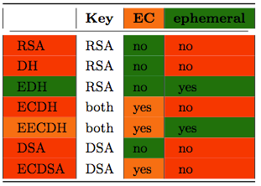
Choosing your own cipher string (2)
Complexity
Multi-dimensional optimisation
Consider strong alternatives to de-facto standards
Potential future solution: generator for settings?

Slide 28
Practical settings
David

Slide 29
What we have so far
Web server: Apache, nginx, MS IIS, lighttpd
Mail: Dovecot, cyrus, Postfix, Exim
DBs: Mysql, Oracle, Postgresql, DB2
VPN: OpenVPN, IPSec, Checkpoint, ...
Proxies: Squid, Pound
GnuPG
SSH
IM servers (jabber, irc)
David

Slide 30
What we would like to see
Mail: Exchange
SIP
RDP
Everything as HTML (easier to copy & paste)
Config generator on the website
David

Slide 31
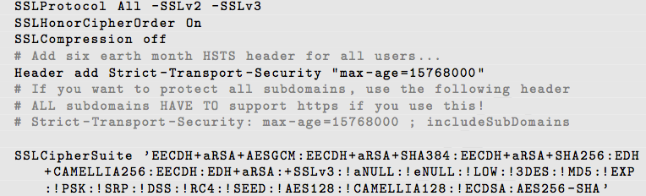
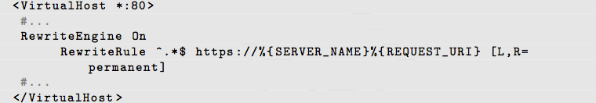
Example: Apache
Selecting cipher suites:
Additionally:
Aaron

Slide 32
Testing
Tobias

Slide 33
How to test? - Tools
openssl s_client (or gnutls-cli)
ssllabs.com: checks for servers as well as clients
xmpp.net
sslscan
SSLyze
Tobias

Slide 34
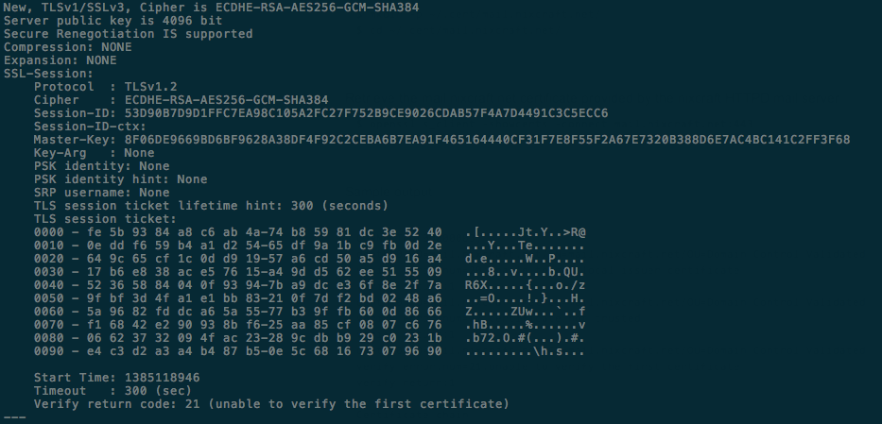
Tools: openss s_client
openssl s_client -showcerts –connect git.bettercrypto.org:443

Slide 35
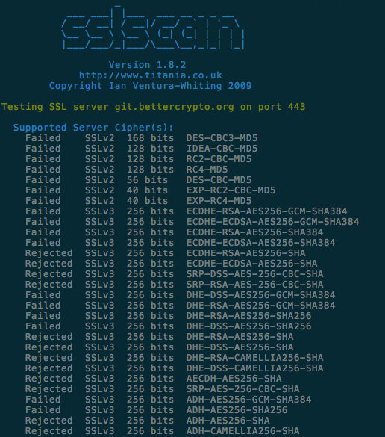
Tools: sslscan

Slide 36
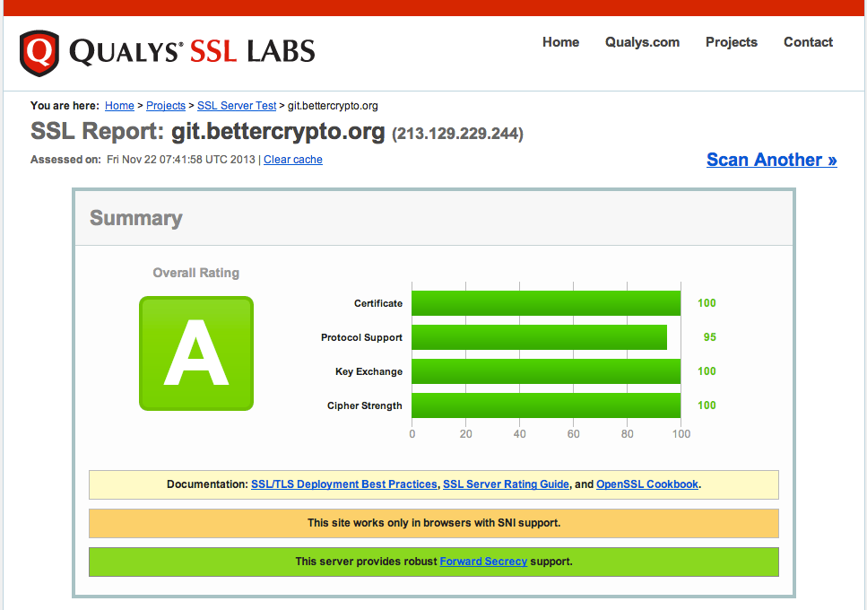
Tools: ssllabs
Aaron

Slide 37
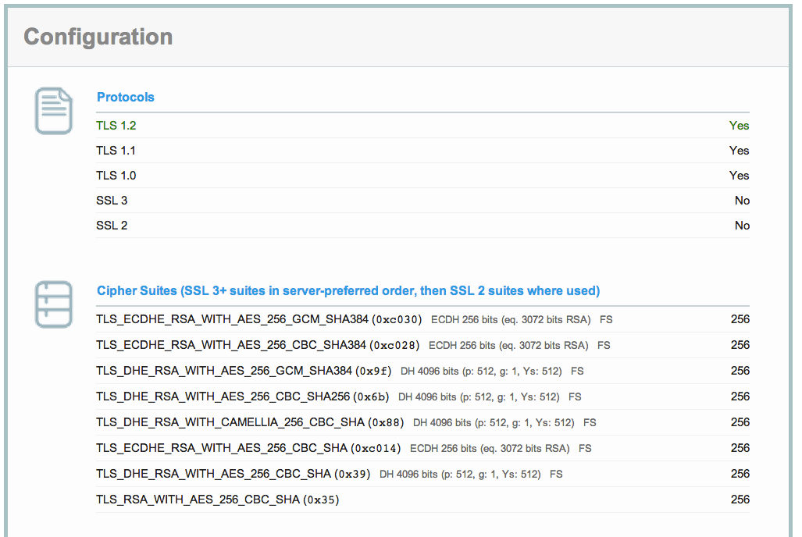
ssllabs (2)

Slide 38
Ssllabs (3)

Slide 39
Wrap-up
Aaron

Slide 40
Current state as of 2014/02/11
Solid basis with Variant (A) and (B)
Public draft was presented at the CCC
Section „cipher suites“ still a bit messy, needs more work
Need to convert to HTML
Aaron

Slide 41
How to participate
We need: cryptologists, sysadmins, hackers
Read the document, find bugs
Subscribe to the mailing list
Understand the cipher strings Variant (A) and (B) before proposing some changes
If you add content to a subsection, make a sample config with variant (B)
Git repo is world-readable
We need:
Add content to an subsection from the TODO list → send us diffs
Reviewers!
Aaron

Slide 42
Links
Website: www.bettercrypto.org
Git repo: https://git.bettercrypto.org
Mailing list: http://lists.cert.at/cgi-bin/mailman/listinfo/ach
Aaron

Slide 43
Thank you!

